Slide 1

TensorFlow Tutorial
Felix A. Portillo
EEC 289Q, UC Davis

Slide 2
Agenda
What is TensorFlow?
Why Would You Use It?
TensorFlow Basics
Building a Model (Example)
Misc.

Slide 3
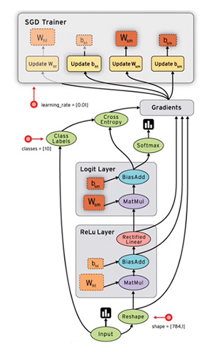
What is TensorFlow?
Google’s framework for machine learning
Can also do reinforcement learning and PDEs
TensorFlow library in Python for numerical computations
C++ backend
Data represented as Tensors
Computations done with data flow graphs
Nodes: Mathematical operations
Edges: Represent data

Slide 4
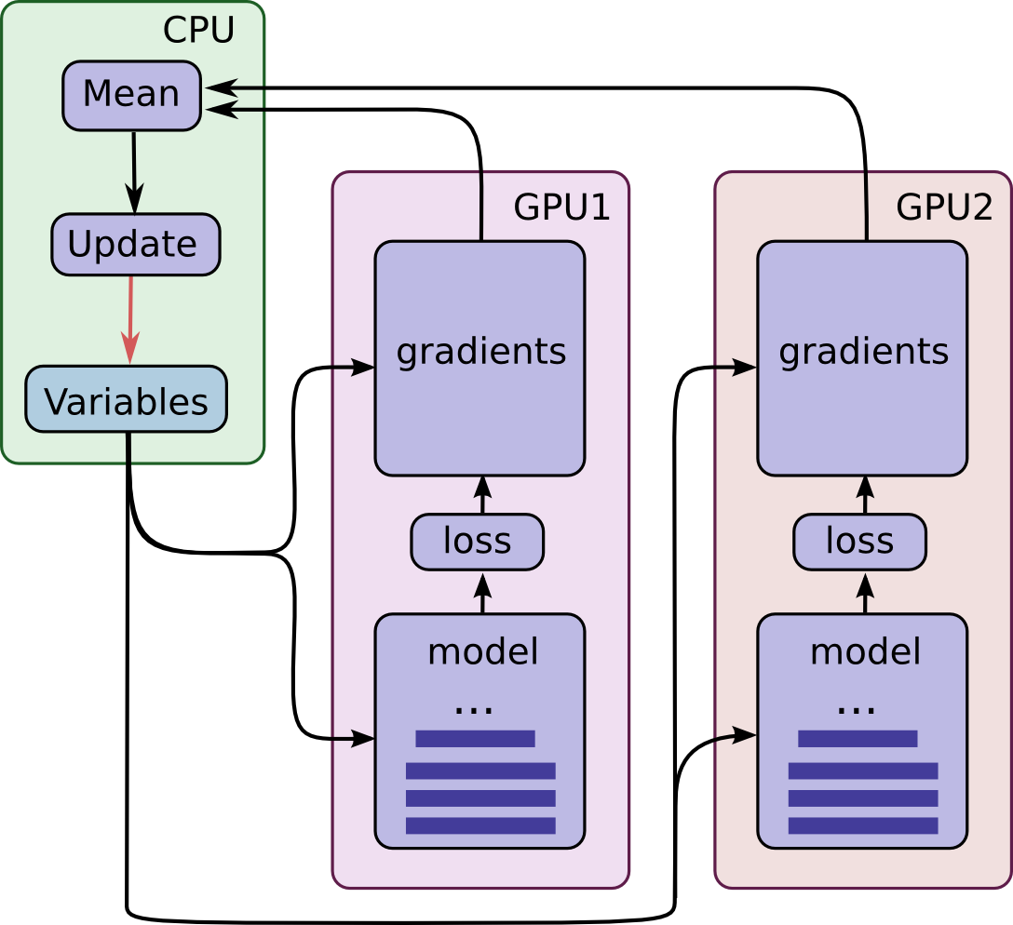
What is TensorFlow?
Has Nvidia GPU support
Can run programs on multiple CPUs and GPUs by assigning nodes to different devices.
Compatible with Numpy, Sklearn, MatPlotLib, and others

Slide 5
Agenda
What is TensorFlow?
Why Would You Use It?
TensorFlow Basics
Building a Model (Example)
Higher Level TF and other notes

Slide 6
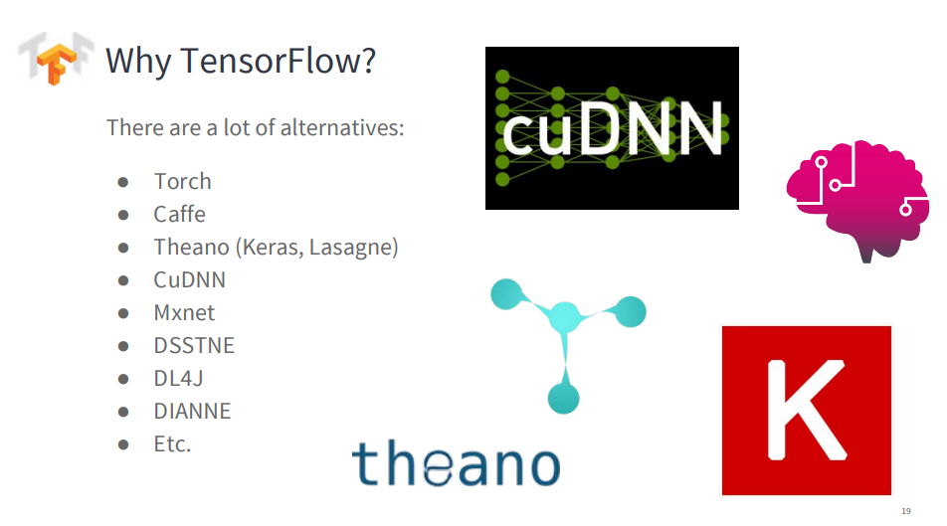
Feys, Matthias. “Introduction to TensorFlow.” LinkedIn SlideShare, 30 Sept. 2016, www.slideshare.net/matthiasfeys/introduction-to-tensorflow-66591270.

Slide 7
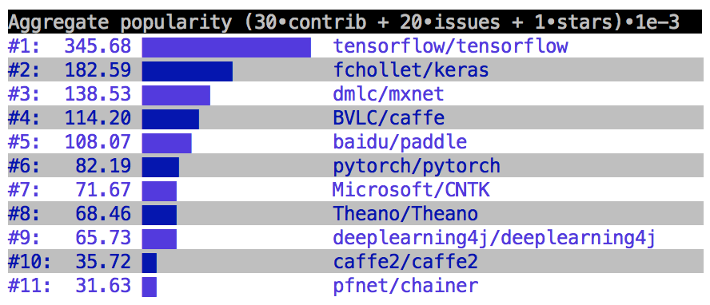
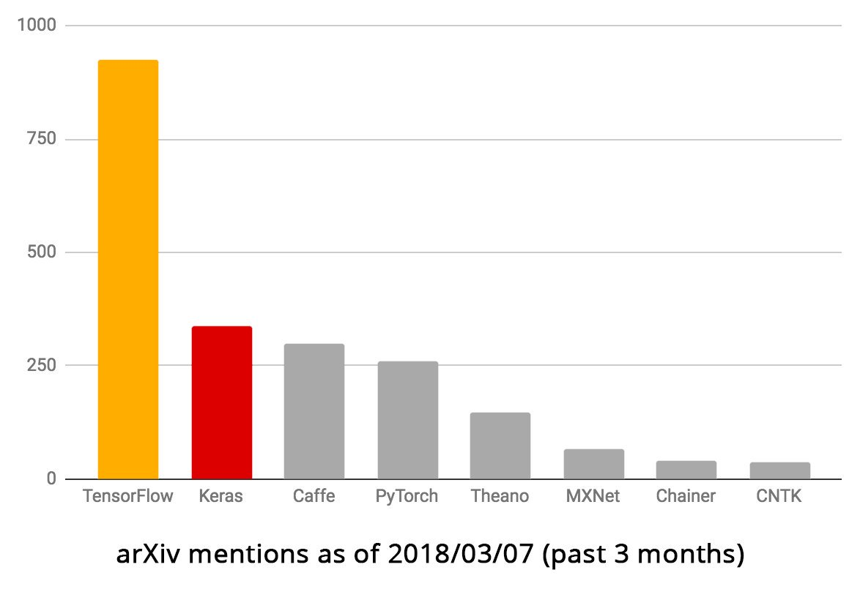
TensorFlow has a large community
GitHub Popularity as of March 2018
https://twitter.com/fchollet/status/971863128341323776

Slide 8
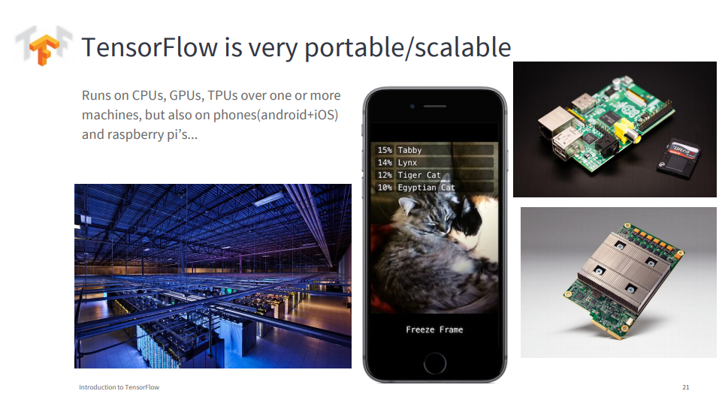
Feys, Matthias. “Introduction to TensorFlow.” LinkedIn SlideShare, 30 Sept. 2016, www.slideshare.net/matthiasfeys/introduction-to-tensorflow-66591270.

Slide 9
Agenda
What is TensorFlow?
Why Would You Use It?
TensorFlow Basics
Building a Model (Example)
Higher Level TF and other notes

Slide 10
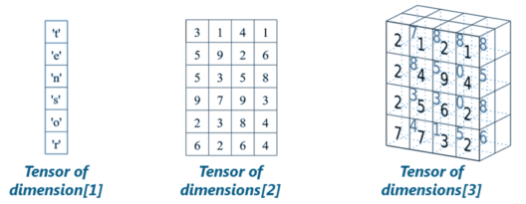
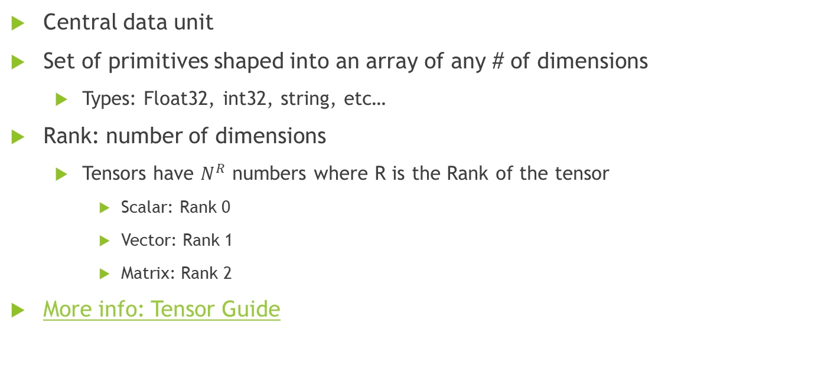
Tensors
Central data unit
Set of primitives shaped into an array of any # of dimensions
Types: Float32, int32, string, etc…
Rank: number of dimensions
Tensors have $N^{R}$ numbers where R is the Rank of the tensor
Scalar: Rank 0
Vector: Rank 1
Matrix: Rank 2
More info: Tensor Guide

Slide 11
Computational Graph
Two Stages:
Building and Running
Nodes: Take 0 or more tensors as inputs, produces tensor as output
Example:
Prints the information about the Tensors. Needs to be Evaluated
import tensorflow as tf
node1 = tf.constant(3.0, dtype=tf.float32) node2 = tf.constant(4.0) # also tf.float32 implicitly print(node1, node2)
Output:
Tensor("Const:0", shape=(), dtype=float32) Tensor("Const_1:0", shape=(), dtype=float32)

Slide 12
Computational Graph
TensorFlow Sessions
Used to execute operation nodes and evaluate information contained in Tensors
Encapsulates the control and state of the runtime.
Need to create Session object and invoke run method
Using previous example:
sess = tf.Session() print(sess.run([node1, node2]))
Output:
[3.0, 4.0]

Slide 13
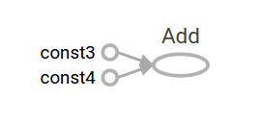
Computational Graph
Build more complicated operations by combining Tensors with operation nodes
Example:
node3 = tf.add(node1, node2) #Add operation print("node3:", node3) print("sess.run(node3):", sess.run(node3))
Output:
node3: Tensor("Add:0", shape=(), dtype=float32) sess.run(node3): 7.0

Slide 14
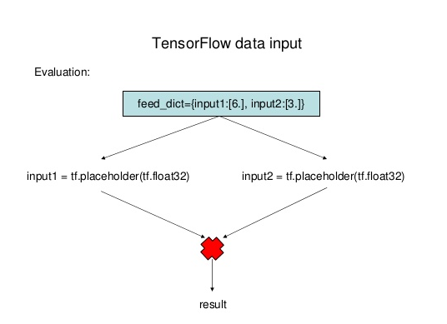
Computational Graph
Graphs can be parameterized to accept external inputs called Placeholders
Create structure of graph without providing specific values
Values passed into Placeholders during runtime
Useful for inputting multiple datasets while reusing the same graph
Pass data in using feed_dict argument in the Session run method

Slide 15
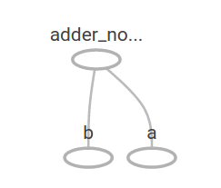
Computational Graph (example)
a = tf.placeholder(tf.float32) b = tf.placeholder(tf.float32) adder_node = a + b # + provides a shortcut for tf.add(a, b)
print(sess.run(adder_node, feed_dict={a: 3, b: 4.5})) print(sess.run(adder_node, feed_dict={a: [1, 3], b: [2, 4]}))
Output:
7.5 [ 3. 7.]

Slide 16
TensorFlow Functions
Used to manipulate or process Tensors
tf.’function_name’(inputs, name=None, other parameters)
Typical function parameters
name: Optional name for operation in graph
dtype: Data type of Tensor
axis: Axis to perform operation on along Tensor

Slide 17
TensorFlow Functions
Example Function purposes:
Numerical Computations (i.e. matmul, add, convolution)
Data Conversion: (i.e. Numpy Array to TensorFlow Tensor)
Activation Functions (i.e. ReLU, Sigmoid, etc…)
Regularization Methods (i.e. Dropout, L2, etc…)
Loss Functions (i.e. log-loss, mean squared error, etc…
Optimizers (i.e. Stochastic Gradient Descent, Adam, RMSProp)

Slide 18
Agenda
What is TensorFlow?
Why Would You Use It?
TensorFlow Basics
Building a Model (Example)
Higher Level TF and other notes

Slide 19
Building a Simple Model
Declare weight and bias parameters
Can be randomly declared as well using tf.random_normal(size);
Declare Placeholders for input and labels.
import tensorflow as tf # Model parameters W = tf.Variable([.3], dtype=tf.float32) b = tf.Variable([-.3], dtype=tf.float32) # Model input and output x = tf.placeholder(tf.float32) y = tf.placeholder(tf.float32)

Slide 20
Building a Simple Model
Set forward pass
Define loss function
Declare an optimizer for the loss
Use Optimizer to minimize loss
linear_model = W*x + b # Forward # loss loss = tf.reduce_sum(tf.square(linear_model - y)) # sum of the squares # optimizer optimizer = tf.train.GradientDescentOptimizer(0.01) train = optimizer.minimize(loss)

Slide 21
Building a Simple Model
Declare Training Data
In this case, just a normal array
Data can come from CSV files, Txt files, Numpy Arrays, etc…
# training data x_train = [1, 2, 3, 4] y_train = [0, -1, -2, -3]

Slide 22
Building a Simple Model
Initialize all variables within a graph
init: handle to the TF graph that initializes all variables
Declare a session
Run init in session. If not, variables remain uninitialized
Over 1000 Iterations: Feed training data to beginning of graph that ends with train
# training loop init = tf.global_variables_initializer() sess = tf.Session() sess.run(init) # reset values to wrong for i in range(1000): sess.run(train, feed_dict={x: x_train, y: y_train})

Slide 23
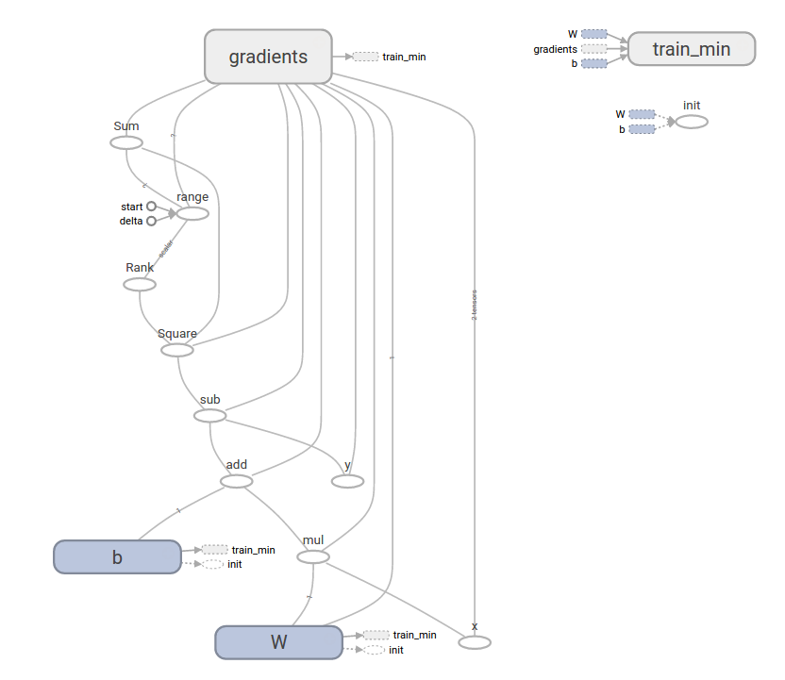

Slide 24
Building a Simple Model
Evaluate training accuracy
Can get values of multiple operation nodes in graph with one call of the sess.run method
# evaluate training accuracy curr_W, curr_b, curr_loss = sess.run([W, b, loss], {x: x_train, y: y_train}) print("W: %s b: %s loss: %s"%(curr_W, curr_b, curr_loss))
Output:
W: [-0.9999969] b: [ 0.99999082] loss: 5.69997e-11

Slide 25
Agenda
What is TensorFlow?
Why Would You Use It?
TensorFlow Basics
Building a Model (Example)
Higher Level TF and other notes

Slide 26

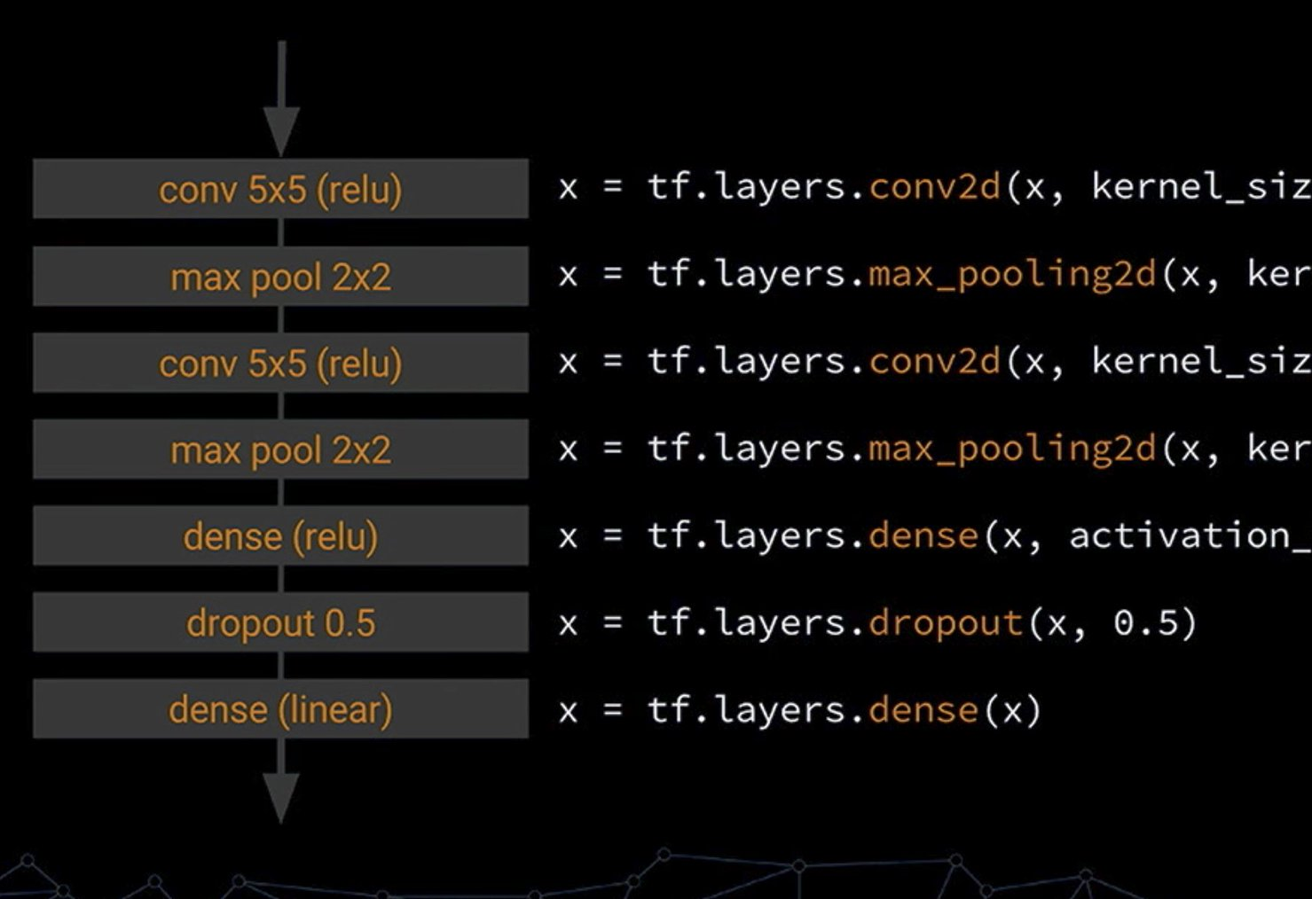
Higher-Level TensorFlow
Higher levels of abstraction available
Keras, tf.keras
tf.layers
Faster Prototyping
Don’t need to create full graph and training loop. In tf.layers:
Define model structure
Create Estimator
Fit model to data
Image: https://twitter.com/rasbt/status/857966842211696640

Slide 27
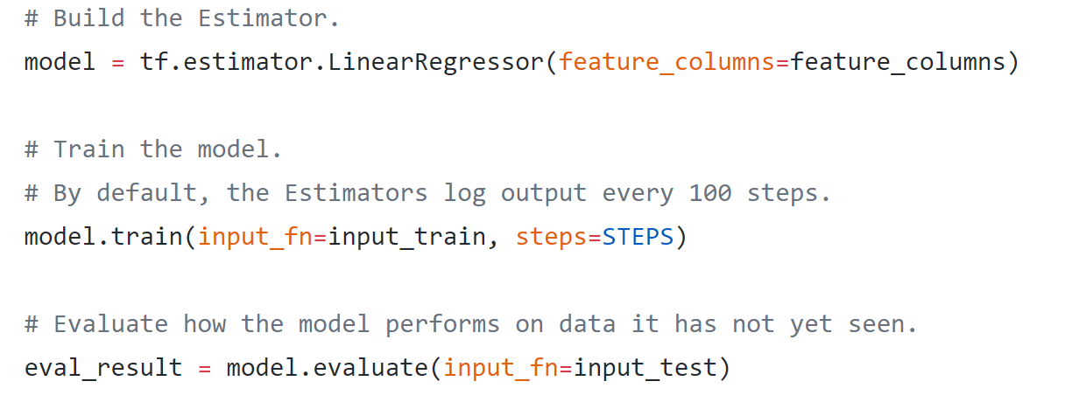
Estimators
Pre-made Estimators
LinearRegressor
DNNClassifier
Custom Estimators
CNNs
Custom models
https://github.com/tensorflow/tensorflow/blob/r1.4/tensorflow/examples/get_started/regression/linear_regression.py

Slide 28
MNIST CNN Example

Slide 29
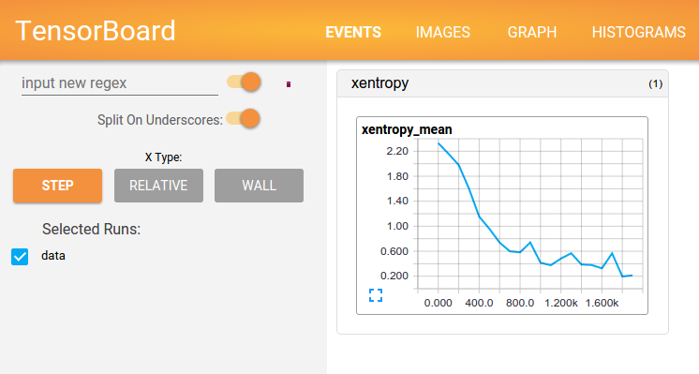
TensorBoard
TensorFlow Visualization Tool
Used to visualize TF Graph, plot results from operations (i.e. Loss over time), and view input data like images

Slide 30
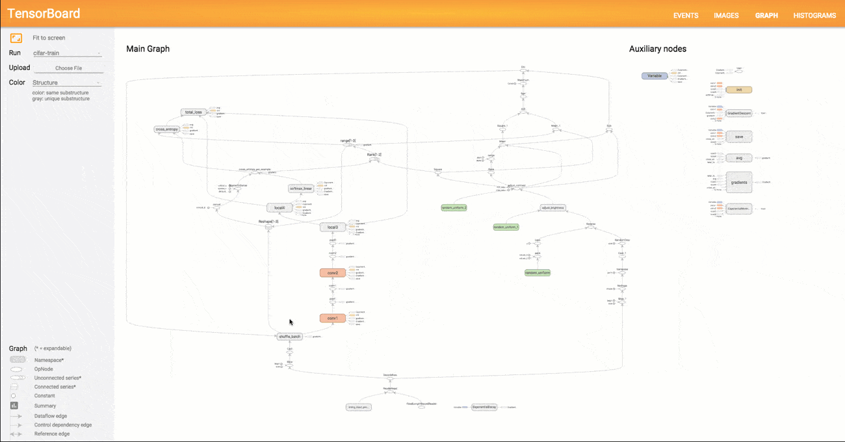

Slide 31
Important Links
Getting Started
TensorFlow Python API
TensorFlow Tutorial for Beginners
TF Dataset API
TensorFlow Program Examples

Slide 32
Questions?

Slide 33
References
Andrii Babii, Senior Lecturer at Kharkiv National University of Radioelectronics Follow. “TensorFlow Example for AI Ukraine2016.” LinkedIn SlideShare, 8 Oct. 2016, www.slideshare.net/AndrewBabiy2/tensorflow-example-for- ai-ukraine2016.
Aymericdamien. “Aymericdamien/TensorFlow-Examples.” GitHub, 18 Oct. 2017, github.com/aymericdamien/TensorFlow-Examples/tree/master/examples.
“Getting Started With TensorFlow | TensorFlow.” TensorFlow, www.tensorflow.org/get_started/get_started.
Nikhil Krishna Nair, Solutions Architect at UST Global Follow. “Tensor Flow.” LinkedIn SlideShare, 11 Aug. 2016, www.slideshare.net/NikhilKrishnaNair/tensor-flow-64896909.
“TensorFlow Tutorial For Beginners.” DataCamp Community, www.datacamp.com/community/tutorials/tensorflow- tutorial.
“Using GPUs | TensorFlow.” TensorFlow, www.tensorflow.org/tutorials/using_gpu.

